Slide 1
Python for Data Science using Anaconda
TDWI Accelerate
Travis E. Oliphant
President, Chief Data Scientist, Co-founder

Slide 2


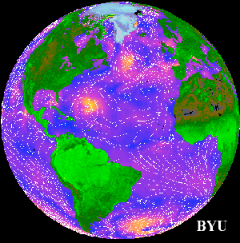
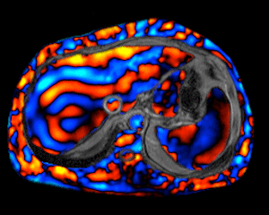
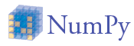


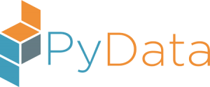
A bit about me
PhD 2001 from Mayo Clinic in Biomedical Engineering (Ultrasound and MRI)
MS/BS degrees in Elec. Comp. Engineering
Creator and Developer of SciPy (1999-2009)
Professor at BYU (2001-2007)
Author of NumPy (2005-2012)
Started Numba (2012)
Founding Chair of NumFOCUS / PyData
Previous Python Software Foundation Director
Co-founder of Continuum Analytics
CEO => President, Chief Data Scientist
SciPy

Slide 3
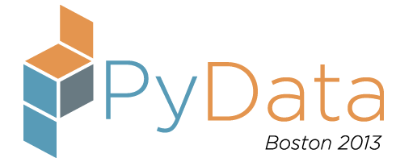
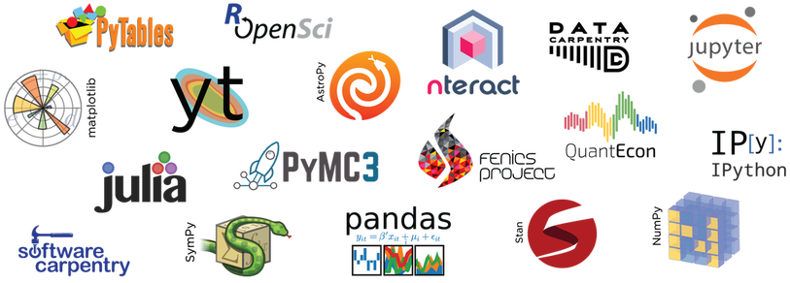
2012 - Created Two Orgs for Sustainable Open Source
Company
Community
Enterprise software, support and services to empower people who change the world to get rapid insight from all of their data — built on open-source that we contribute to and sustain.

Slide 4
Data Science is growing with Python leading the way

Slide 5
Dealing with a lot of information: OODA loop
Observe — Gather data
Orient — How will you interpret the data
Decide — Make a decision
Act — Execute decision and gather feedback

Slide 6
Data Science Workflow
Data Products
Exploratory Data Analysis and Viz
Reports
Applications
Understand Data
Notebooks
Decisions
and
Actions
Getting Data
Models
Dashboards
Understand World
Microservices
New Data

Slide 8


Bringing Technology Together

Slide 9


Accelerate adoption of Data Science
http://continuum.io/downloads
PYTHON & R OPEN SOURCE ANALYTICS
NumPy
SciPy
Pandas
Scikit-learn
Jupyter/IPython
Numba
Matplotlib
Spyder
TensorFlow
Cython
Theano
Scikit-image
NLTK
Dask
Caffe
dplyr
shiny
ggplot2
tidyr
caret
PySpark
& 1000+ packages
Notes:
Easy to install
Agile data exploration
Powerful data analysis
Simple to collaborate
Accessible to everyone
730+ popular Python & R packages
Compiled for Windows, Mac, and Linux
Single-user free for everyone
Foundation of Anaconda Enterprise
Extensible via conda package manager
Sandbox packages & libraries
It’s modular nature means you can customize your configuration or define sandboxes with just the set of tools you need for a particular project -- along with specific versions -- all without resorting to VMs or containers. Furthermore there are rolling updates of the individual packages so you can always be up to date with the latest releases of the 720+ Continuum-curated Open Data Science packages.
While it is Python-centric, it is not Python-exclusive. There is strong support for R, with hundreds of R packages available in the Anaconda ecosystem.

Slide 10


















ANACONDA Trusted by Industry Leaders
http://continuum.io/downloads
Financial Services
Risk Mgmt, Quant modeling, Data exploration and processing, algorithmic trading, compliance reporting
Government
Fraud detection, data crawling, web & cyber data analytics, statistical modeling
Healthcare & Life Sciences
Genomics data processing, cancer research, natural language processing for health data science
High Tech
Customer behavior, recommendations, ad bidding, retargeting, social media analytics
Retail & CPG
Engineering simulation, supply chain modeling, scientific analysis
Oil & Gas
Pipeline monitoring, noise logging, seismic data processing, geophysics
Notes:
Michele

Slide 11

Insight
Decisions
Actions
Results
Creations
…
Applications
Dashboards
Notebooks
MicroServices
Open Data Science
Virtual Data Lake / Data Catalogue
…
DATA
HDFS
Oracle
Teradata
Cassandra
S3
Flat Files

Slide 12
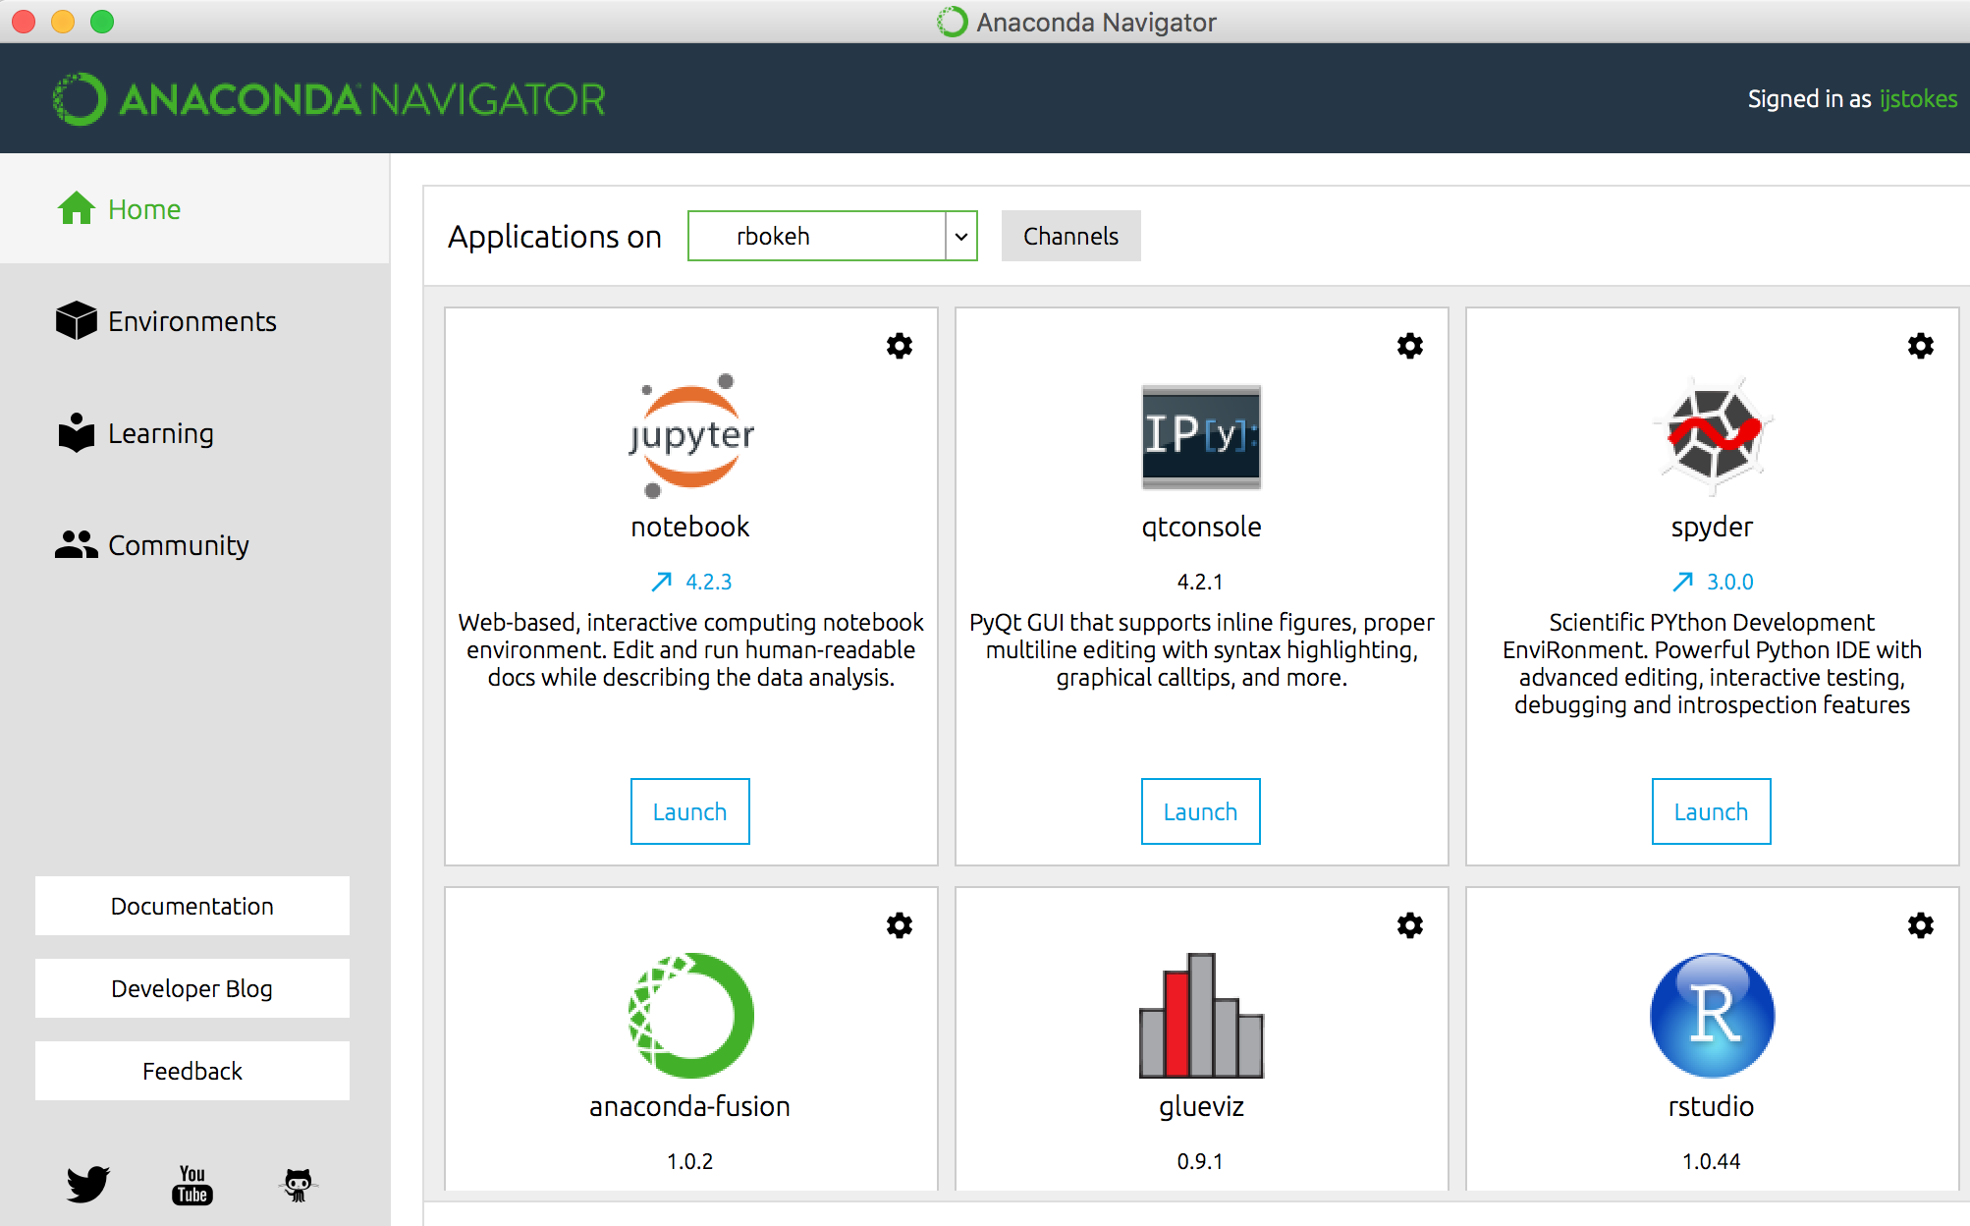
Notes:
Single user experience

Slide 13
Conda Sandboxing Technology
B
Language independent
Platform independent
No special privileges required
No VMs or containers
Enables:
Reproducibility
Collaboration
Scaling
“conda – package everything”
A
Jupyter
NumPy
v1.10
NumPy
v1.11
C
Pandas
v0.16
Pandas
v0.18
R Essentials
Python v2.7
Python v3.4
R
conda
Notes:
Essential for technical conversations and SE team.

Slide 14


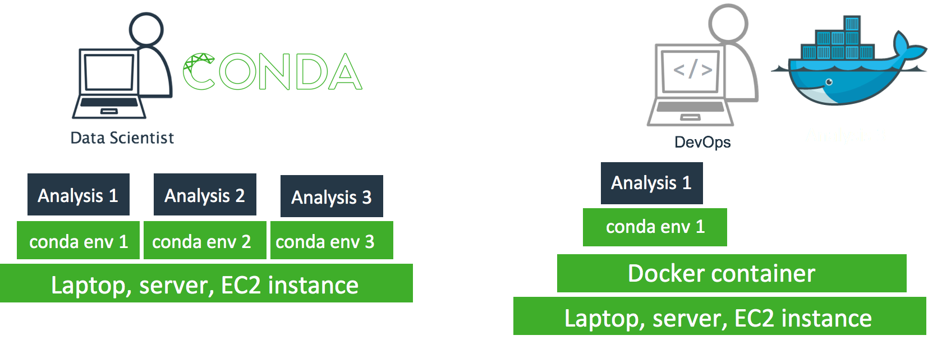
Conda for Deployment
Development
Deployment

Slide 15
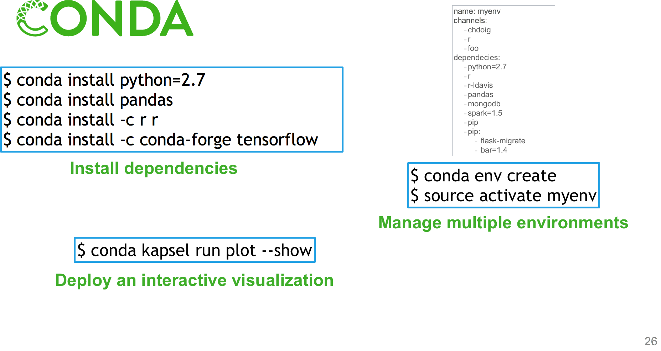

$ anaconda-project run plot —show

Slide 16
Python Ecosystem

Slide 17
Bokeh
Numba

Slide 18
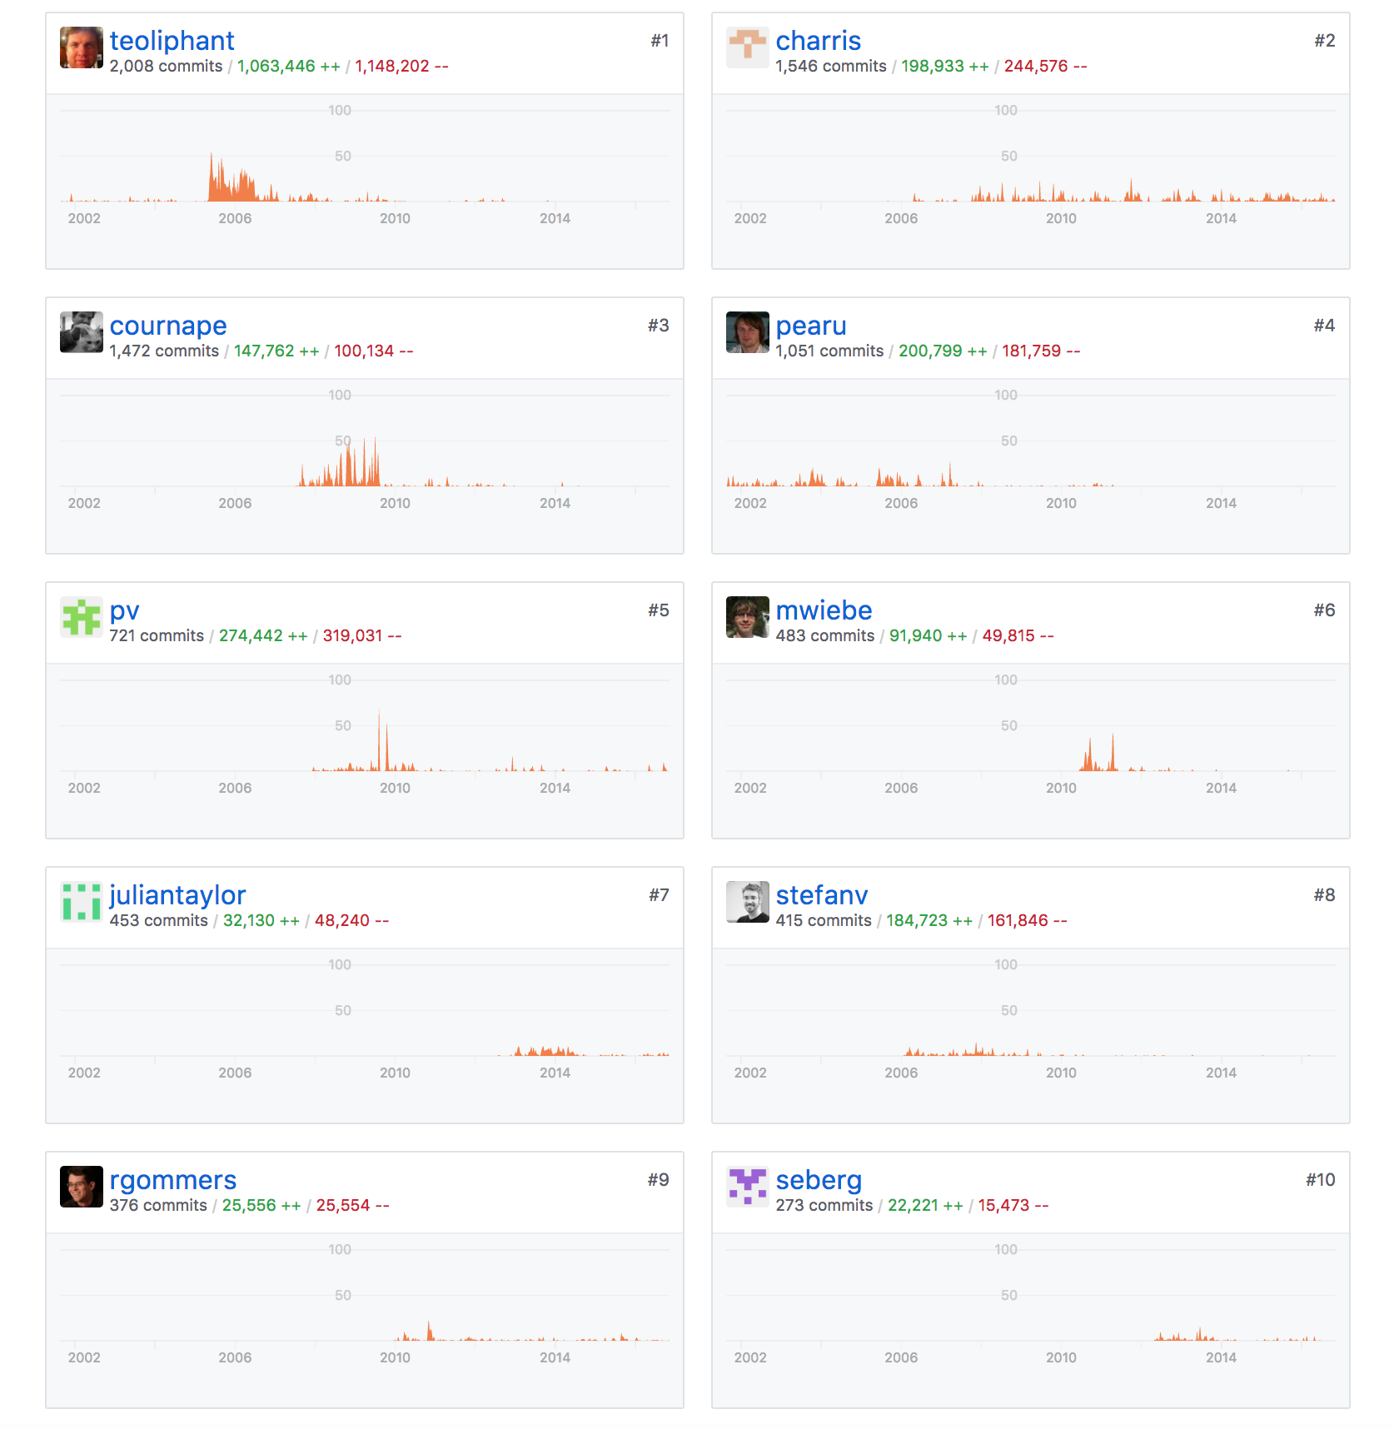
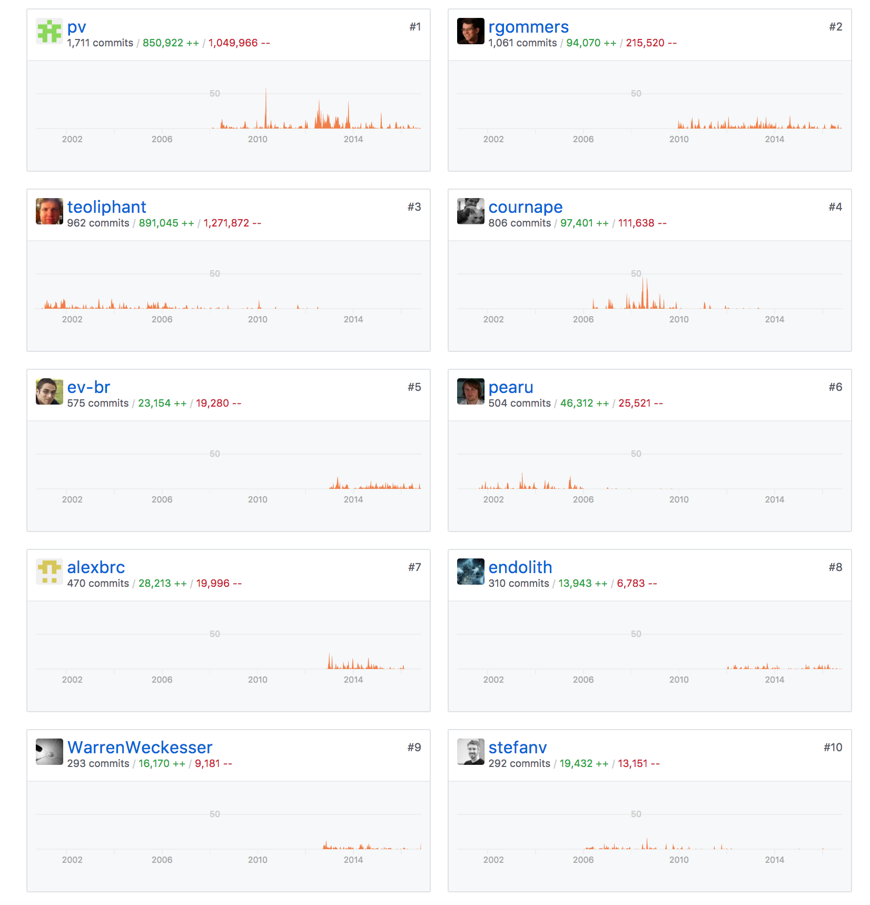

An impressive community effort
NumPy ~ 509 contributors
SciPy ~ 478 contributors

Slide 19
NumPy

Slide 20
Without NumPy
from math import sin, pi
def sinc(x):
if x == 0:
return 1.0
else:
pix = pi*x
return sin(pix)/pix
def step(x):
if x > 0:
return 1.0
elif x < 0:
return 0.0
else:
return 0.5
>>> import functions as f
>>> xval = [x/3.0 for x in range(-10,10)]
>>> yval1 = [f.sinc(x) for x in xval]
>>> yval2 = [f.step(x) for x in xval]
Python is a great language but needed a way to operate quickly and cleanly over multi-dimensional arrays.
functions.py

Slide 21
With NumPy
from numpy import sin, pi
from numpy import vectorize
import functions as f
vsinc = vectorize(f.sinc)‏
def sinc(x):
pix = pi*x
val = sin(pix)/pix
val[x==0] = 1.0
return val
vstep = vectorize(f.step)‏
def step(x):
y = x*0.0
y[x>0] = 1
y[x==0] = 0.5
return y
>>> import functions2 as f
>>> from numpy import *
>>> x = r_[-10:10]/3.0
>>> y1 = f.sinc(x)‏
>>> y2 = f.step(x)‏
Offers N-D array, element-by-element functions, and basic random numbers, linear algebra, and FFT capability for Python
http://numpy.org
Fiscally sponsored by NumFOCUS
functions2.py

Slide 22

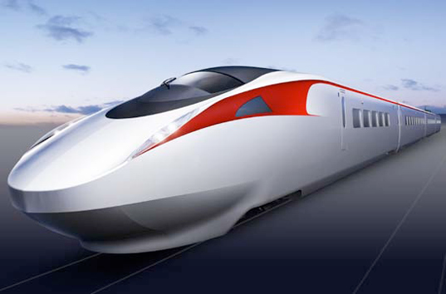
NumPy: an Array Extension of Python
Data: the array object
slicing and shaping
data-type map to Bytes
Fast Math (ufuncs):
vectorization
broadcasting
aggregations

Slide 23
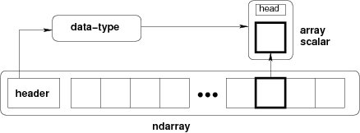
NumPy Array
Key Attributes
dtype
shape
ndim
strides
data
shape

Slide 24
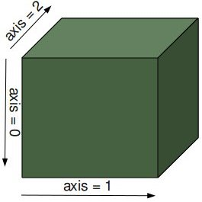
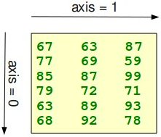

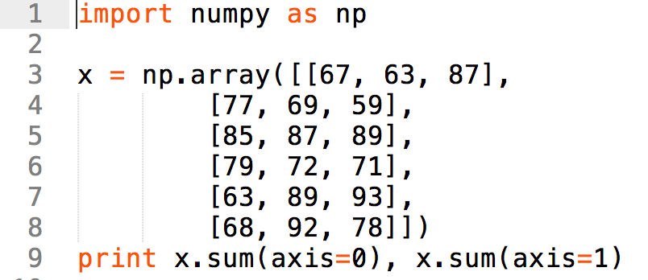
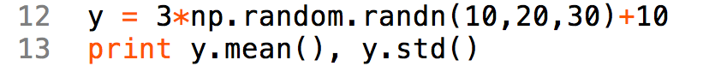
NumPy Examples
3d array
2d array
9.98330639789 2.96677717122
[439 472 477]
[217 205 261 222 245 238]

Slide 25
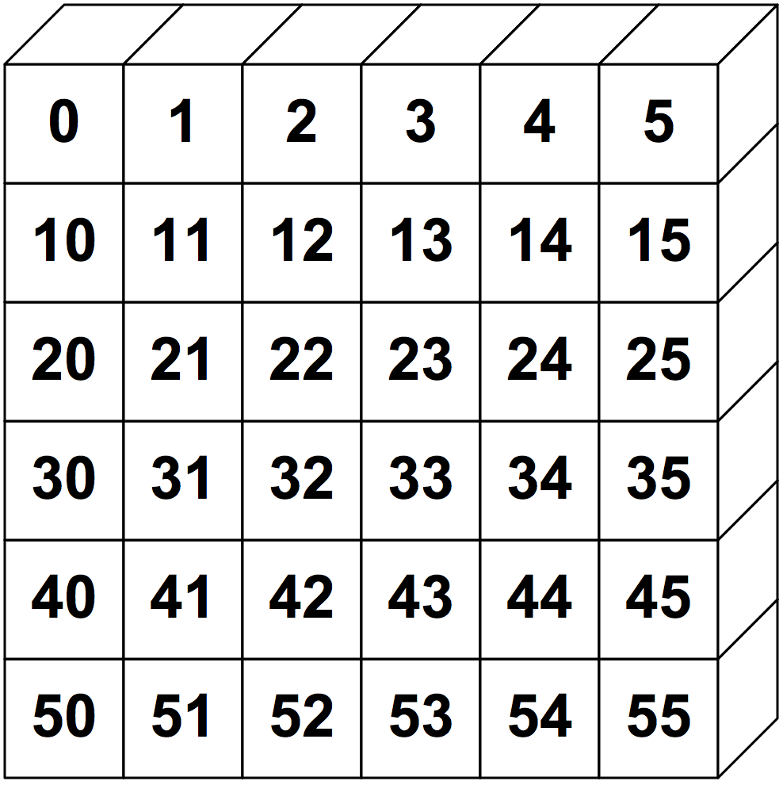
NumPy Slicing (Selection)
>>> a[0,3:5]
array([3, 4])
>>> a[4:,4:]
array([[44, 45],
[54, 55]])
>>> a[:,2]
array([2,12,22,32,42,52])
>>> a[2::2,::2]
array([[20, 22, 24],
[40, 42, 44]])

Slide 26
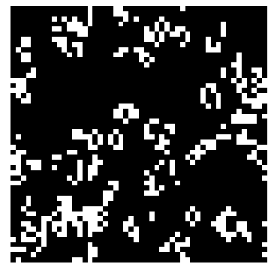
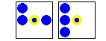
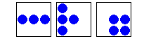
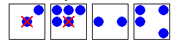
Conway’s game of Life
Dead cell with exactly 3 live neighbors will come to life
A live cell with 2 or 3 neighbors will survive
With too few or too many neighbors, the cell dies

Slide 27
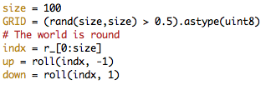
Conway’s Game of Life in NumPy
Initialization
Update Step

Slide 28
Summary
Provides foundational N-dimensional array composed of homogeneous elements of a particular “dtype”
The dtype of the elements is extensive (but not very extensible)
Arrays can be sliced and diced with simple syntax to provide easy manipulation and selection.
Provides fast and powerful math, statistics, and linear algebra functions that operate over arrays.
Utilities for sorting, reading and writing data also provided.

Slide 29
SciPy

Slide 30
SciPy
“Distribution of Python Numerical Tools masquerading as a Library”
Name | Description
cluster | KMeans and Vector Quantization
fftpack | Discrete Fourier Transform
integrate | Numerical Integration
interpolate | Interpolation routines
io | Data Input and Output
linalg | Fast Linear algebra
misc | Utilities
ndimage | N-dimensional Image processing
Name | Description
odr | Orthogonal Distance Regression
optimize | Constrained and Unconstrained Optimization
signal | Signal Processing Tools
sparse | Sparse Matrices and Algebra
spatial | Spatial Data Structures and Algorithms
special | Special functions (e.g. Bessel)
stats | Statistical Functions and Distributions

Slide 31
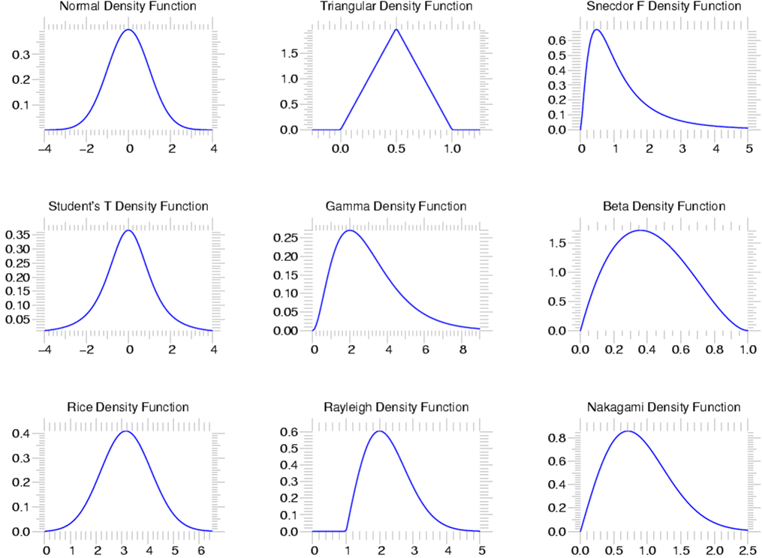
scipy.stats --- Continuous Distributions
94 continuous distributions!
Methods on all Random Variable Objets.
pdf
cdf
rvs
ppf
stats

Slide 32
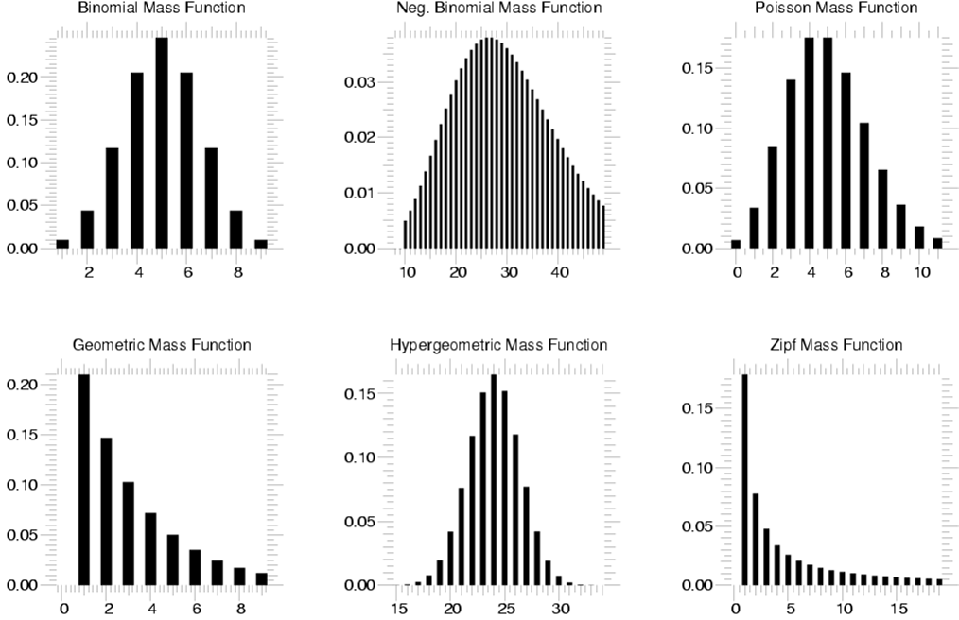
scipy.stats --- Discrete Distributions
13 standard discrete distributions (plus any arbitrary finite RV)
Methods
pdf
cdf
rvs
ppf
stats

Slide 33
Matplotlib

Slide 34
a powerful plotting engine
import numpy as np
import matplotlib.mlab as mlab
import matplotlib.pyplot as plt
np.random.seed(0)
# example data
mu = 100 # mean of distribution
sigma = 15 # standard deviation of distribution
x = mu + sigma * np.random.randn(437)
num_bins = 50
fig, ax = plt.subplots()
# the histogram of the data
n, bins, patches = ax.hist(x, num_bins, normed=1)
# add a 'best fit' line
y = mlab.normpdf(bins, mu, sigma)
ax.plot(bins, y, '--')
ax.set_xlabel('Smarts')
ax.set_ylabel('Probability density')
ax.set_title(r'Histogram of IQ: $\mu=100$, $\sigma=15$')
# Tweak spacing to prevent clipping of ylabel
fig.tight_layout()
plt.show()

Slide 35
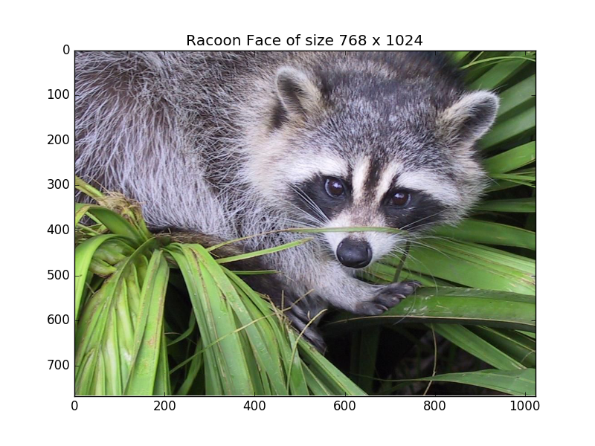
a powerful plotting engine
import matplotlib.pyplot as plt
import scipy.misc as misc
im = misc.face()
ax = plt.imshow(im)
plt.title('Racoon Face of size %d x %d' % im.shape[:2])
plt.savefig(‘face.png’)

Slide 36
a powerful plotting engine
import matplotlib.pyplot as plt
import numpy as np
with plt.xkcd():
fig = plt.figure()
ax = fig.add_axes((0.1, 0.2, 0.8, 0.7))
ax.spines['right'].set_color('none')
ax.spines['top'].set_color('none')
plt.xticks([])
plt.yticks([])
ax.set_ylim([-30, 10])
data = np.ones(100)
data[70:] -= np.arange(30)
plt.annotate('THE DAY I REALIZED\nI COULD COOK BACON\nWHENEVER I WANTED’,
xy=(70, 1),
arrowprops=dict(arrowstyle=‘->'),
xytext=(15, -10))
plt.plot(data)
plt.xlabel('time')
plt.ylabel('my overall health')
fig.text(0.5, 0.05, '"Stove Ownership" from xkcd by Randall Monroe',
ha='center')

Slide 37
a powerful plotting engine
from mpl_toolkits.mplot3d import Axes3D
import matplotlib.pyplot as plt
from matplotlib import cm
from matplotlib.ticker import LinearLocator, FormatStrFormatter
import numpy as np
fig = plt.figure()
ax = fig.gca(projection='3d')
# Make data.
X = np.arange(-5, 5, 0.25)
Y = np.arange(-5, 5, 0.25)
X, Y = np.meshgrid(X, Y)
R = np.sqrt(X**2 + Y**2)
Z = np.sin(R)
# Plot the surface.
surf = ax.plot_surface(X, Y, Z, cmap=cm.coolwarm, linewidth=0, antialiased=False)
# Customize the z axis.
ax.set_zlim(-1.01, 1.01)
ax.zaxis.set_major_locator(LinearLocator(10))
ax.zaxis.set_major_formatter(FormatStrFormatter('%.02f'))
# Add a color bar which maps values to colors.
fig.colorbar(surf, shrink=0.5, aspect=5)
plt.show()

Slide 38
Pandas

Slide 39
Easy Data Wrangling
Adds indexes and labels to 1-d and 2-d NumPy arrays (Series and DataFrame)
Many convenience functions and methods to manipulate messy data-sets including time-series.
Powerful indexing with automatic data alignment.
Easy handling of missing data.
Allows easy joining and merging Data Sets
Pivots and reshaping (split-apply-combine)
Powerful group-by operations with summarization
Builtin visualization using labels and indexes

Slide 40
Easy Data Wrangling
Series Data Structure
built for 1-dimensional series data
homogeneous data
Two arrays. One of data and another which is the index that can be a homogeneous array of any type like integers, objects, or date-times.
DataFrame
built for 2-dimensional collections of tabular data (think Excel sheet)
heterogeneous data comprised of multiple Series
includes an index column allowing sophisticated selection and alignment

Slide 41
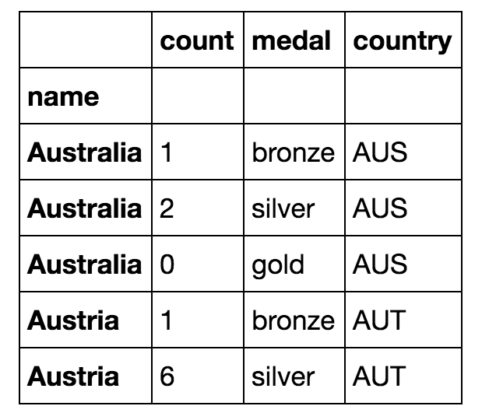
Easy Data Wrangling
medals = pd.read_csv('data/medals.csv', index_col='name')
medals.head()
gold = medals['medal'] == 'gold'
won = medals['count'] > 0
medals.loc[gold & won, 'count'].sort_values().plot(kind='bar', figsize=(12,8))

Slide 42
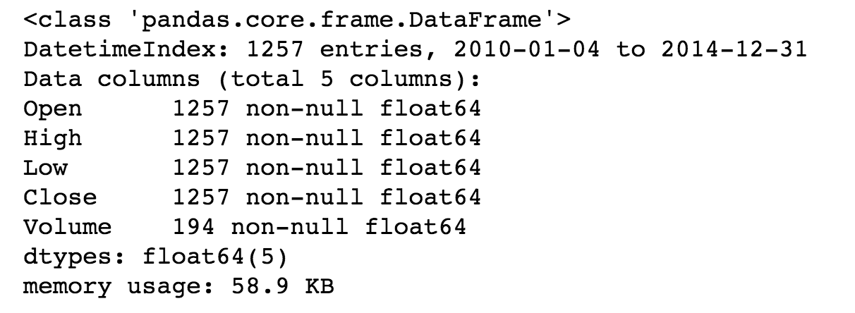
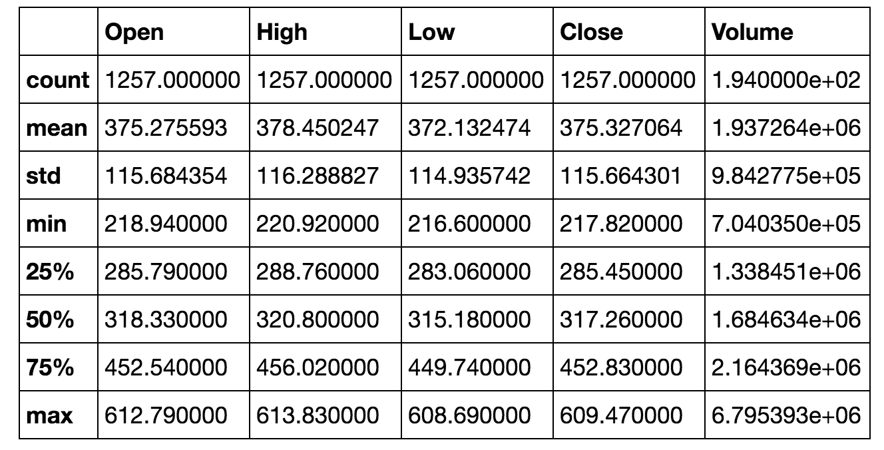
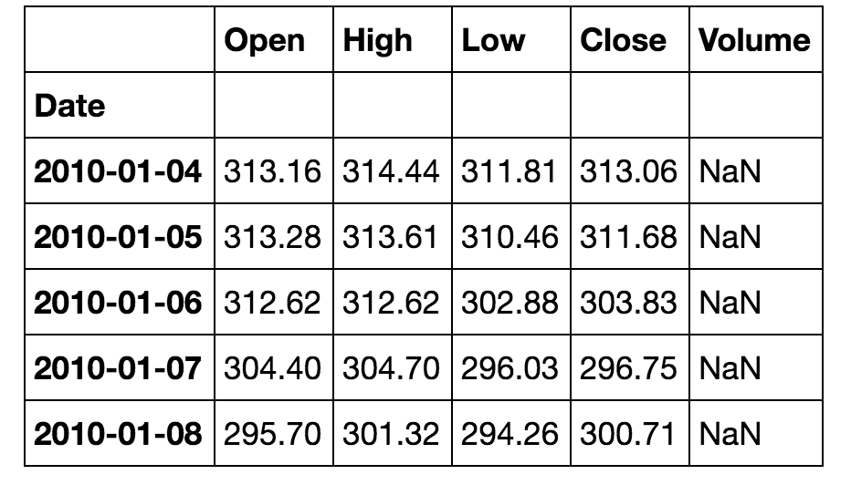
Easy Data Wrangling
google = pd.read_csv('data/goog.csv', index_col='Date', parse_dates=True)
google.info()
google.head()
google.describe()

Slide 43
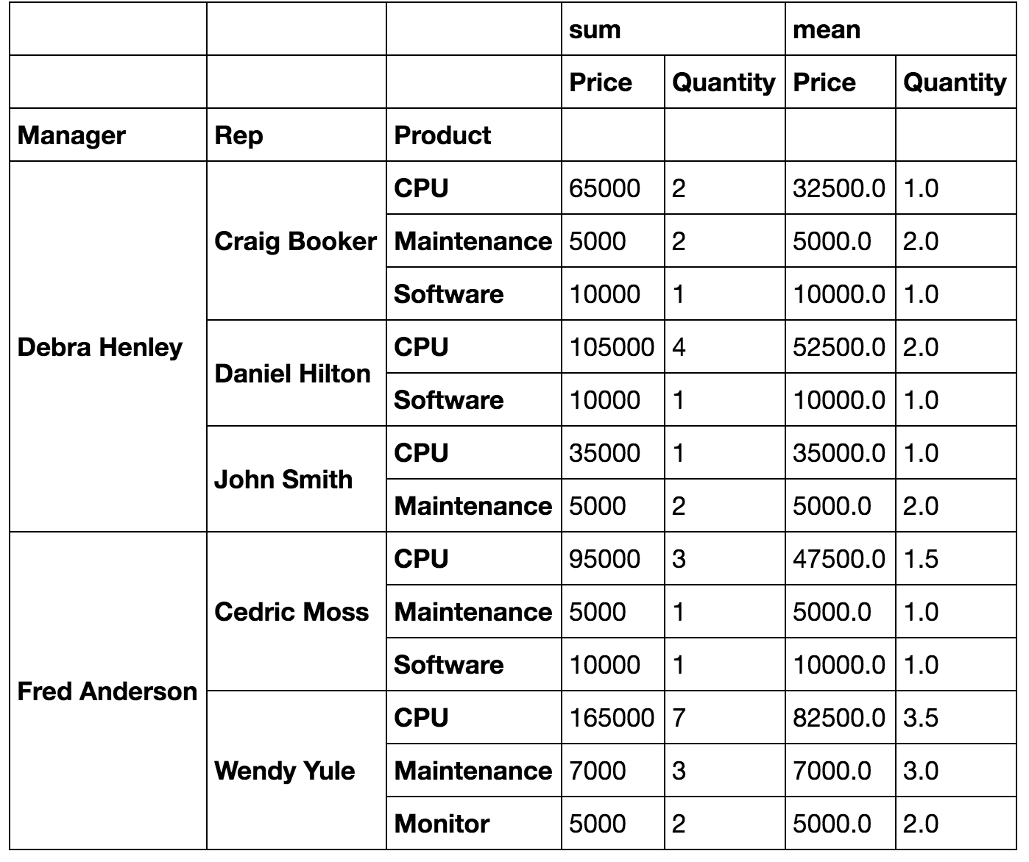
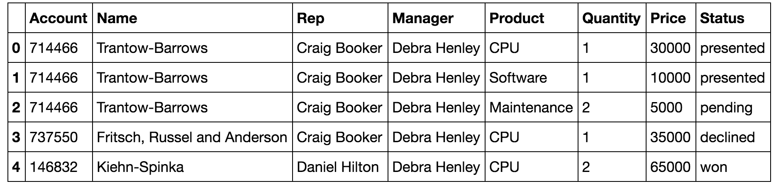
Easy Data Wrangling
df = pd.read_excel("data/pbpython/salesfunnel.xlsx")
df.head()
table = pd.pivot_table(df,
index=["Manager","Rep","Product"],
values=["Price","Quantity"],
aggfunc=[np.sum,np.mean])

Slide 44
Scikit-Learn

Slide 45
Machine Learning made easy
Supervised Learning — uses “labeled” data to train a model
Regression — predicted variable is continuous
Classification — predicted variable is discrete
Unsupervised Learning
Clustering — discover categories in the data
Density Estimation — determine representation of data
Dimensionality Reduction — represent data with fewer variables or feature vectors
Reinforcement Learning — “goal-oriented” learning (e.g. drive a car)
Deep Learning — neural networks with many layers
Semi-supervised Learning (use some labeled data for training)

Slide 47
Basic scikit-learn experience
1) Create or Load Data
>>> from sklearn import datasets
>>> iris = datasets.load_iris()
>>> digits = datasets.load_digits()
A Scikit-learn dataset is a “dictionary-like” object with input data
stored as the .data attribute and labels stored as the .target attribute
.data attribute is always a 2D array (n_samples, n_features)
May need to extract features from raw data to produce data scikit-learn can use

Slide 48
Basic scikit-learn experience
2) Choose Model (or Build Pipeline of Models)
>>> from sklearn import svm
>>> clf = svm.SVC(gamma=0.001, C=100.)
Most models are model-families and have “hyper-parameters” that specify
the specific model function. Good values for these can be found via grid-search
and cross-validation (easy target for parallelization).
Here “gamma” and “C” are hyper-parameters.
Many choices of models: http://scikit-learn.org/stable/supervised_learning.html

Slide 49
Basic scikit-learn experience
3) Train the Model
>>> clf.fit(data[:-1], labels[:-1])
Models have a “fit” method which updates the parameters-to-be-estimated in the model in-place so that after fitting the model is “trained”
For validation and scoring you need to leave out some of the data to use later. cross-validation (e.g. k-fold) techniques can also be parallelized easily.
Here we “leave-one-out” (or n-fold)

Slide 50
Basic scikit-learn experience
4) Predict new values
>>> clf.predict(data[-1:])
Prediction of new data uses the trained parameters of the model. Cross-validation can be used to understand how sensitive the model is to different partitions of the data.
>>> from sklearn.model_selection import cross_val_score
>>> scores = cross_val_score(clf, data, target, cv=10)
array([ 0.96…, 1. …, 0.96… , 1. ])

Slide 51
Jupyter

Slide 52
The Jupyter Notebook is an open-source web application that allows you to create and share documents that contain live code, equations, visualizations and explanatory text. Uses include: data cleaning and transformation, numerical simulation, statistical modeling, machine learning and much more.

Slide 53
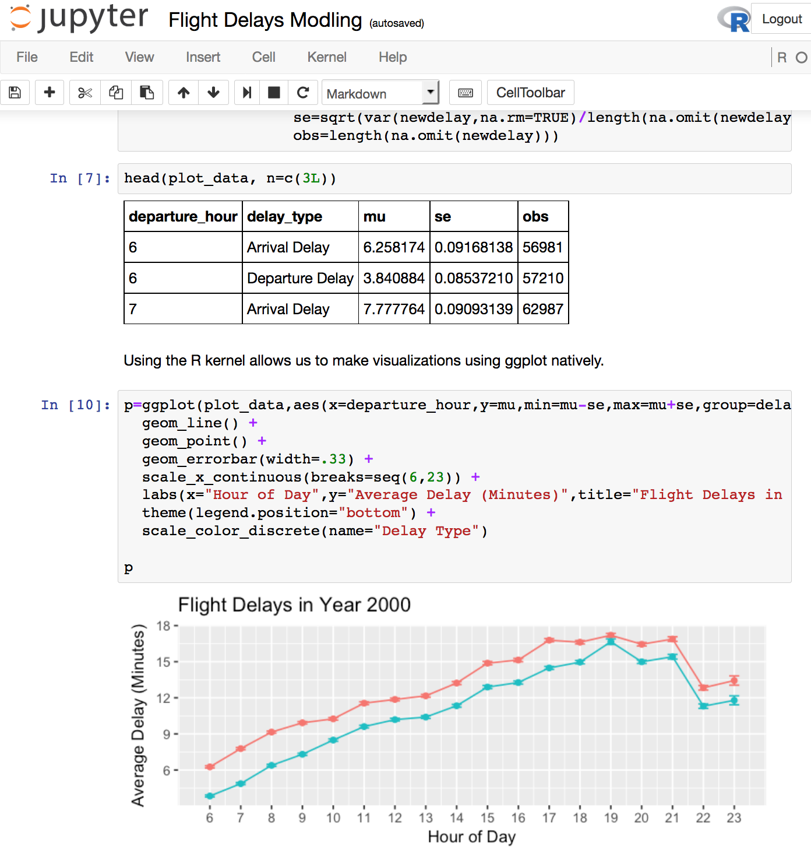
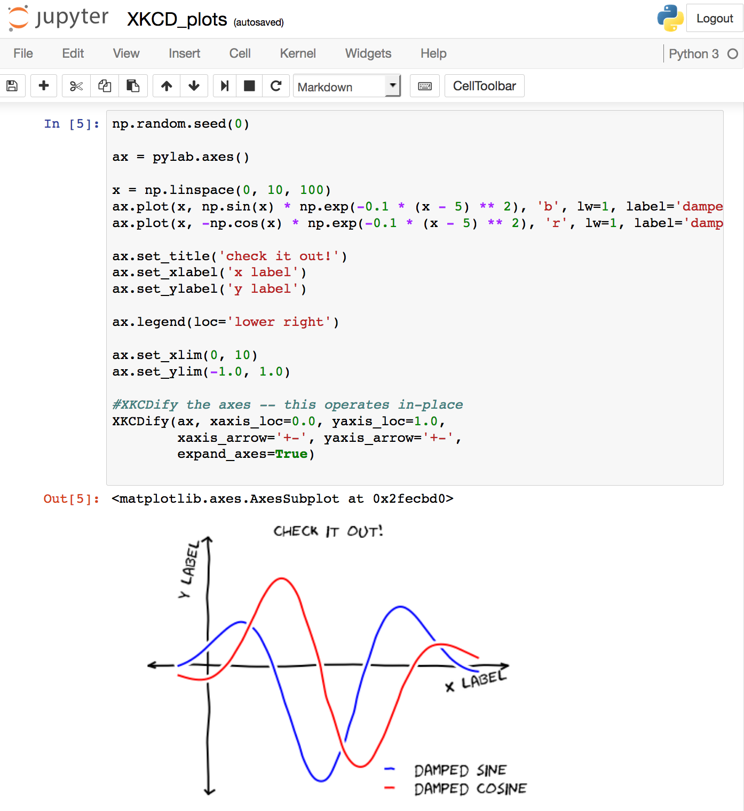

Slide 54
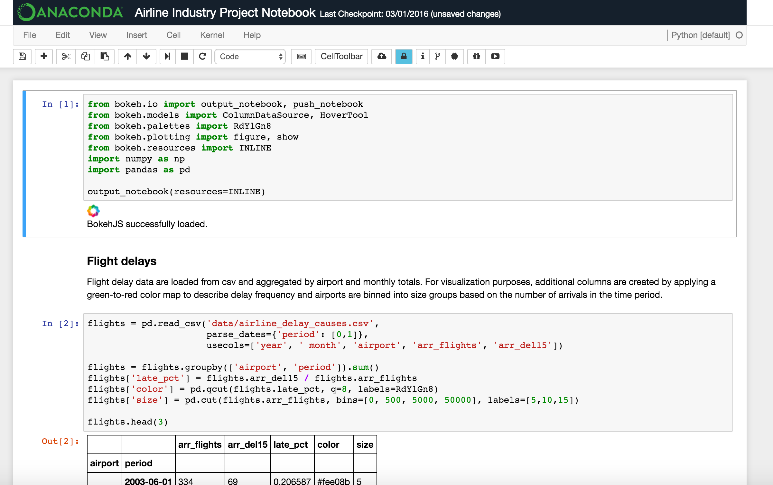
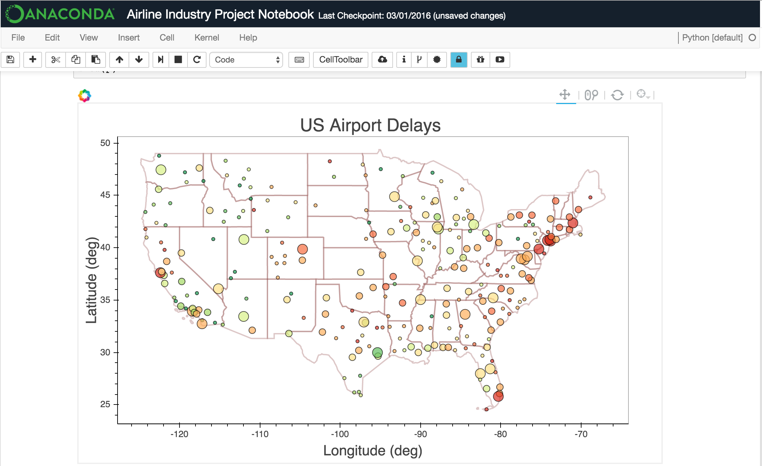
Collaborative Executable Notebooks
Advanced notebook extensions
Data lineage
Interactive Visualizations

Slide 55
Interactive Data Vizualization Apps with Bokeh

Slide 56
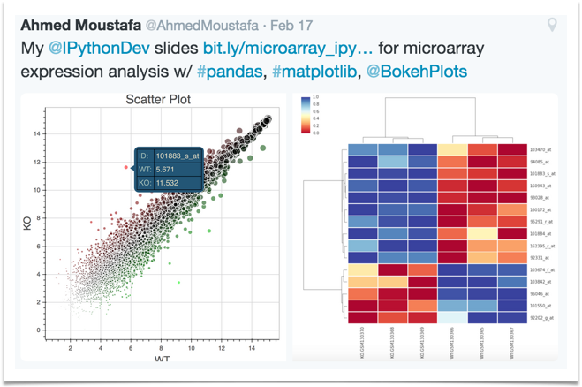
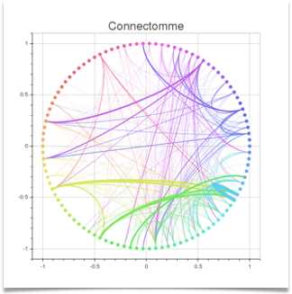

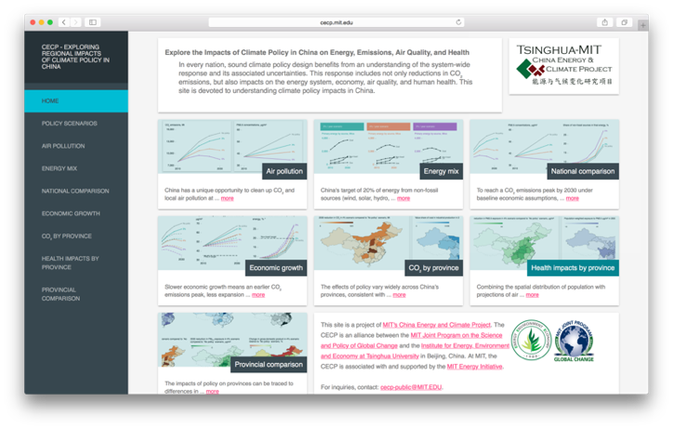
Interactive Data Visualization
Interactive viz, widgets, and tools
Versatile high level graphics
Streaming, dynamic, large data
Optimized for the browser
No Javascript
With or without a server

Slide 57
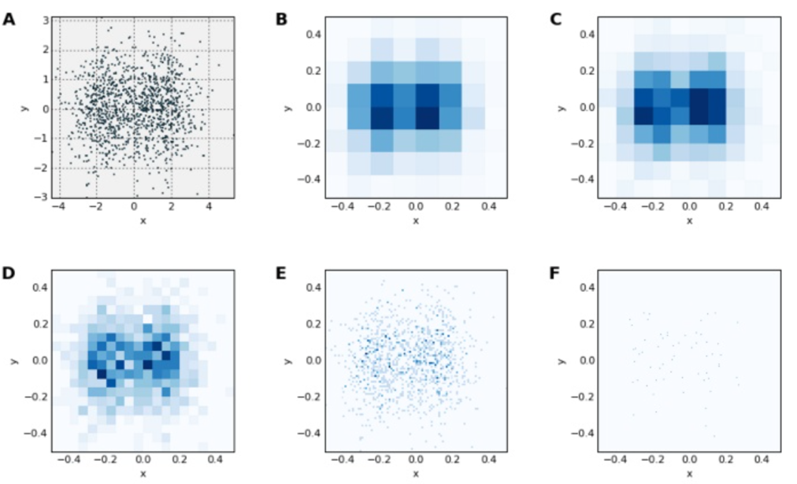
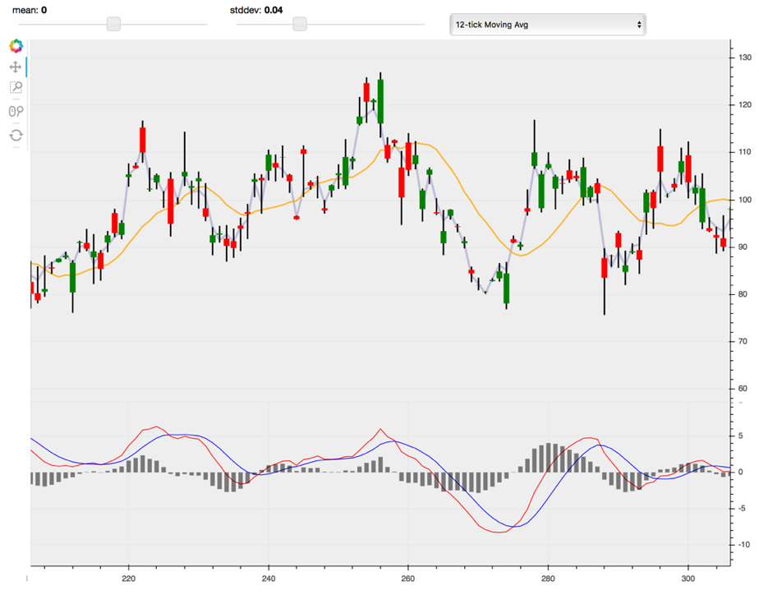
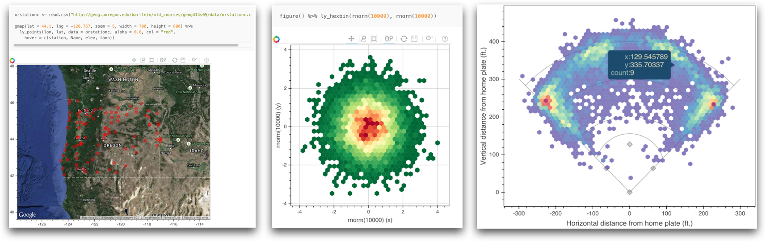
Rapid Prototyping Visual Apps
Python interface
R interface
Smart plotting

Slide 58
Plotting Billions of Points and Map Integration with Datashader

Slide 59
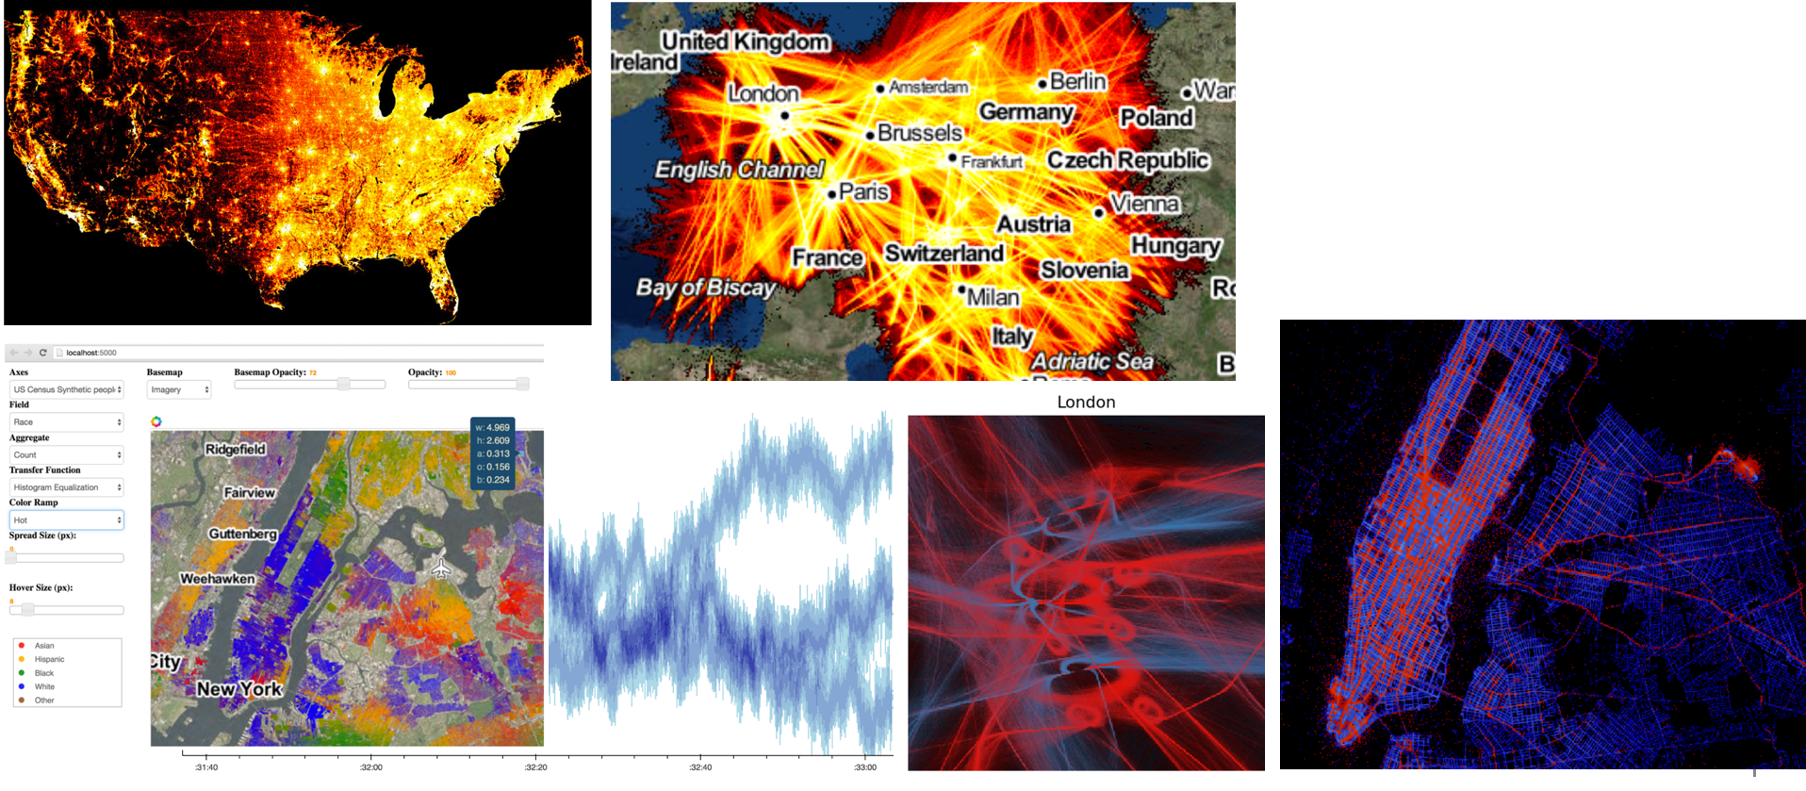
Datashader: Rendering a Billion Points of Data
datashader provides a fast, configurable visualization pipeline for faithfully revealing even very large datasets
Each of these visualizations requires just a few lines of code and no magic numbers to adjust by trial and error.

Slide 60
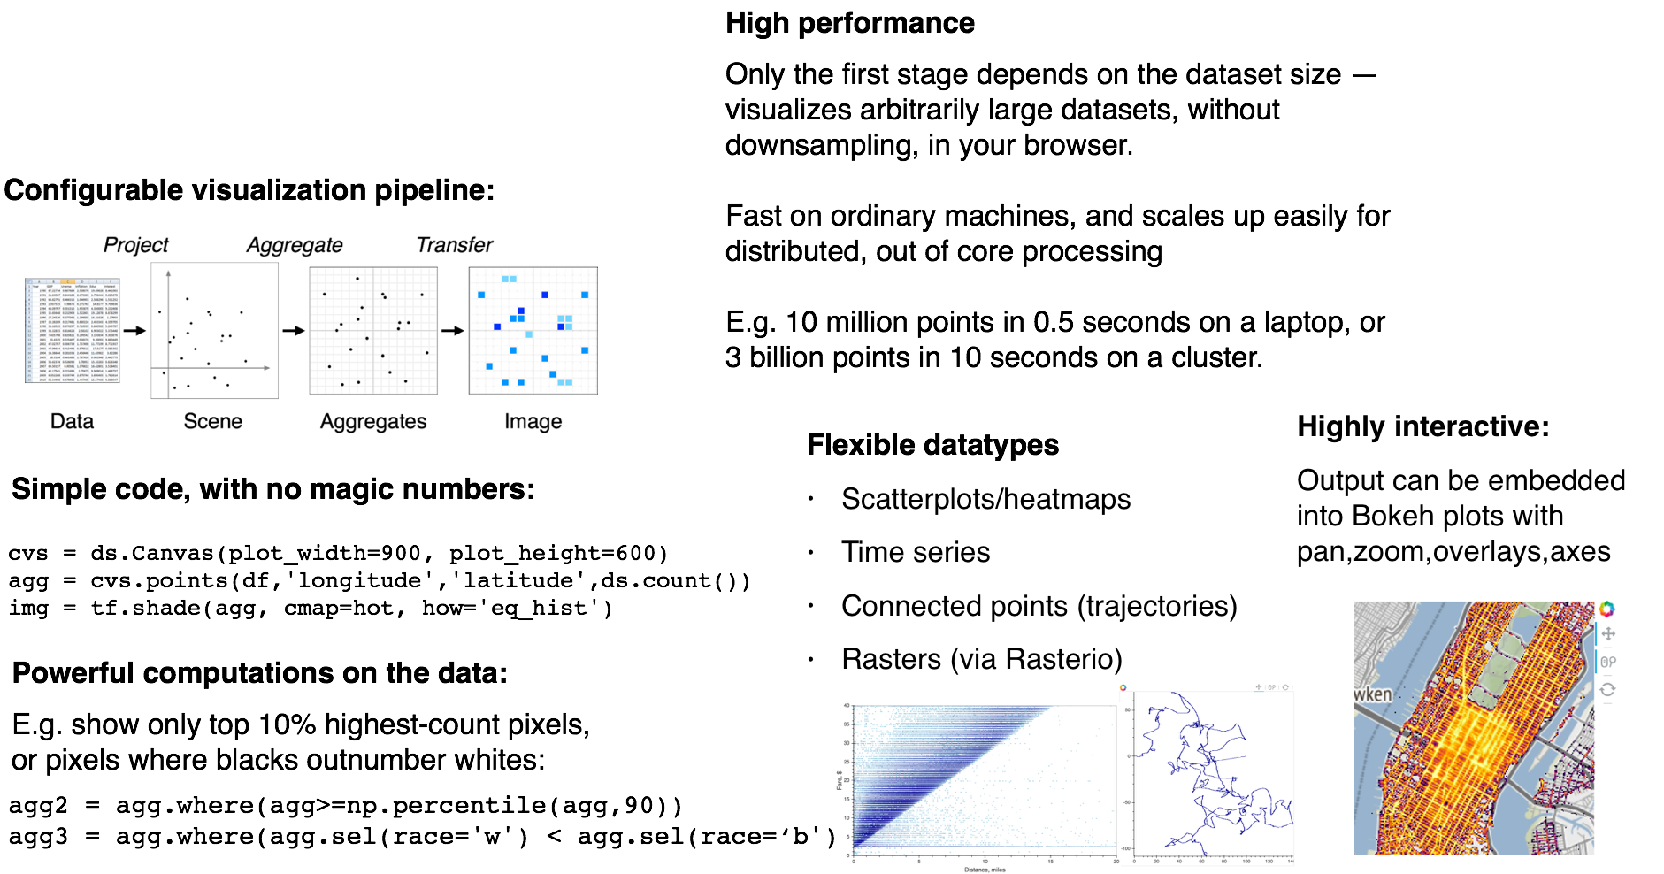
Datashader

Slide 61
Data Visualization and Applications made easy with Holoviews

Slide 62
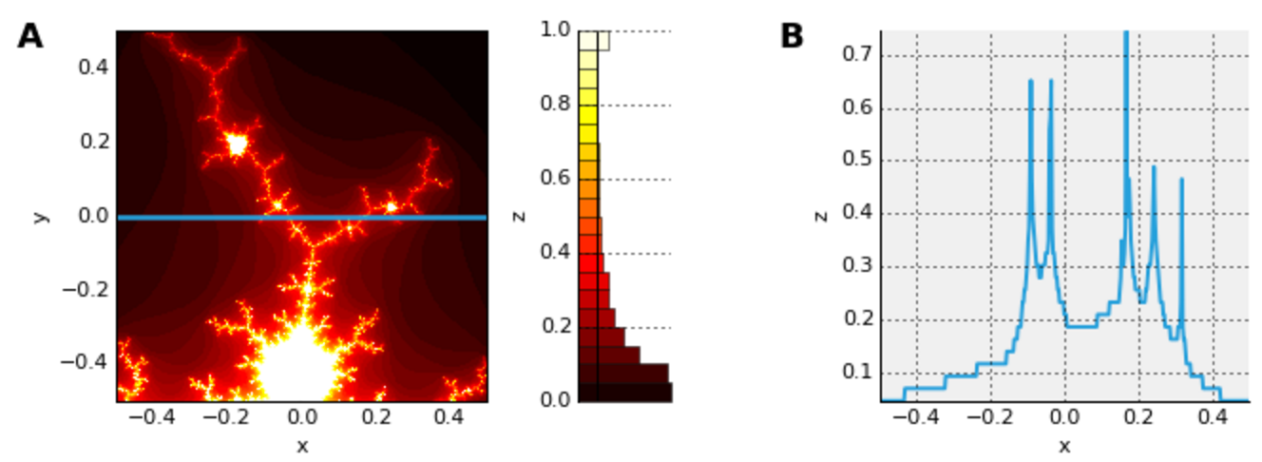
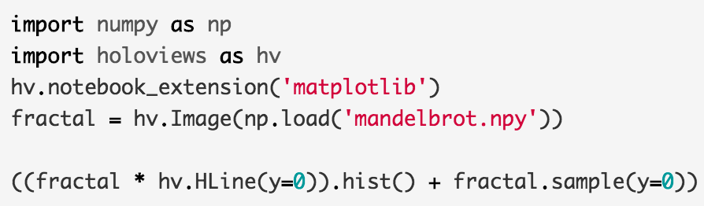
HoloViews: Stop plotting your data
HoloViews makes it simple to create beautiful interactive Bokeh or Matplotlib visualizations of complex data.
Exploring data can be tedious if you use a plotting library directly, because you will need to specify details about your data (units, dimensions, names, etc.) every time you construct a new type of plot.
With HoloViews, you instead annotate your data once, and then flexible plotting comes for free — HoloViews objects just display themselves, alone or in any combination.
It’s now easy to lay out subfigures, overlay traces, facet or animate a multidimensional dataset, sample or aggregate to reduce dimensionality, preserving the metadata each time so the results visualize themselves.

Slide 63
https://anaconda.org/jbednar/nyc_taxi-paramnb/notebook
Data Widgets and
Applications from
Jupyter Notebooks!
tiles = gv.WMTS(WMTSTileSource(url='https://server.arcgisonline.com/ArcGIS/rest/services/'
'World_Imagery/MapServer/tile/{Z}/{Y}/{X}.jpg'))
tile_options = dict(width=800,height=475,xaxis=None,yaxis=None,bgcolor='black',show_grid=False)
passenger_counts = sorted(df.passenger_count.unique().tolist())
class Options(hv.streams.Stream):
alpha = param.Magnitude(default=0.75, doc="Alpha value for the map opacity")
colormap = param.ObjectSelector(default=cm["fire"], objects=cm.values())
plot = param.ObjectSelector(default="pickup", objects=["pickup","dropoff"])
passengers = param.ObjectSelector(default=1, objects=passenger_counts)
def make_plot(self, x_range=None, y_range=None, **kwargs):
map_tiles = tiles(style=dict(alpha=self.alpha), plot=tile_options)
df_filt = df[df.passenger_count==self.passengers]
points = hv.Points(gv.Dataset(df_filt, kdims=[self.plot+'_x', self.plot+'_y'], vdims=[]))
taxi_trips = datashade(points, width=800, height=475, x_sampling=1, y_sampling=1,
cmap=self.colormap, element_type=gv.Image,
dynamic=False, x_range=x_range, y_range=y_range)
return map_tiles * taxi_trips
selector = Options(name="")
paramnb.Widgets(selector, callback=selector.update)
hv.DynamicMap(selector.make_plot, kdims=[], streams=[selector, RangeXY()])

Slide 64
Scaling Up and Out with Numba and Dask

Slide 65
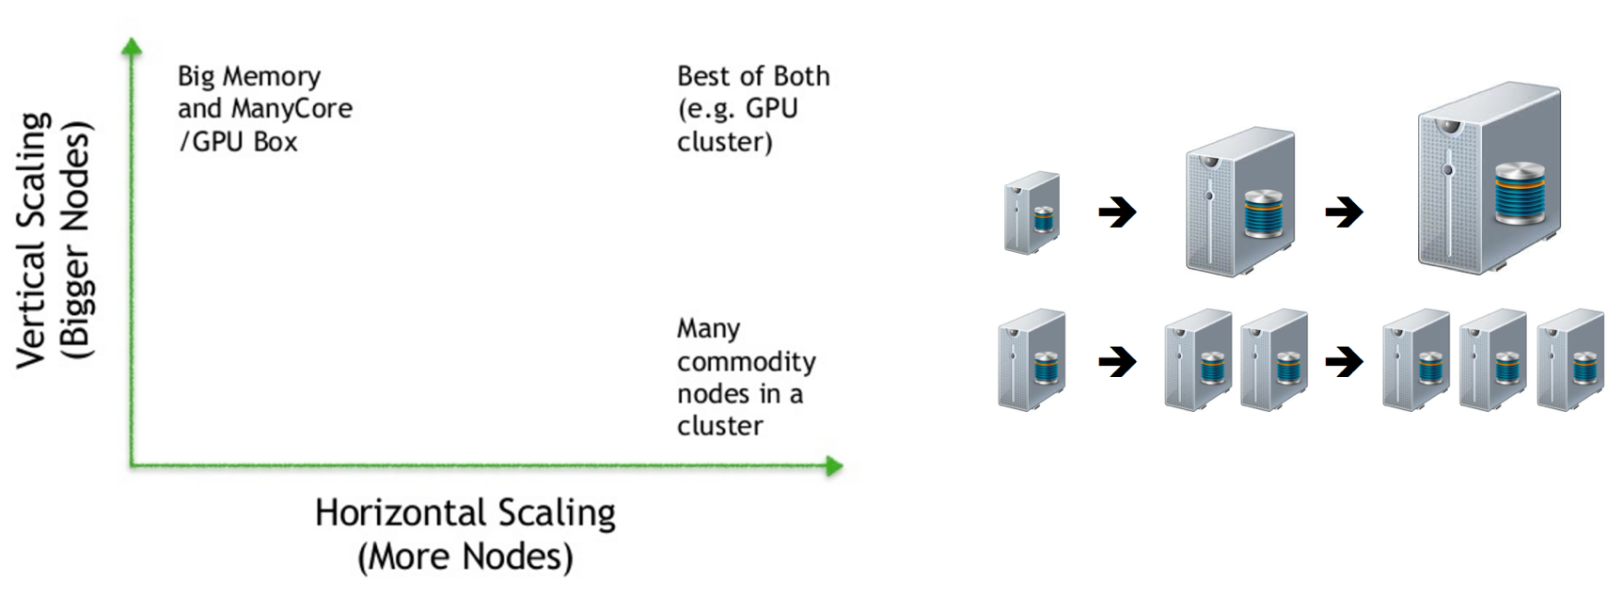
Scale Up vs Scale Out
Blaze
Big Memory &
Many Cores
/ GPU Box
Best of Both
(e.g. GPU Cluster)
Numba
Scale Up
(Bigger Nodes)
Dask
Many commodity nodes in a cluster
Scale Out
(More Nodes)

Slide 66
Scaling Up! Optimized Python with JIT compilation from Numba

Slide 67
Numba
Started in 2012
Release 31 (0.31) in February
Version 1.0 coming in 2017
Particularly suited to Numeric computing
Lots of features!
Ahead of Time Compilation
Wide community adoption and use
conda install numba

Slide 68
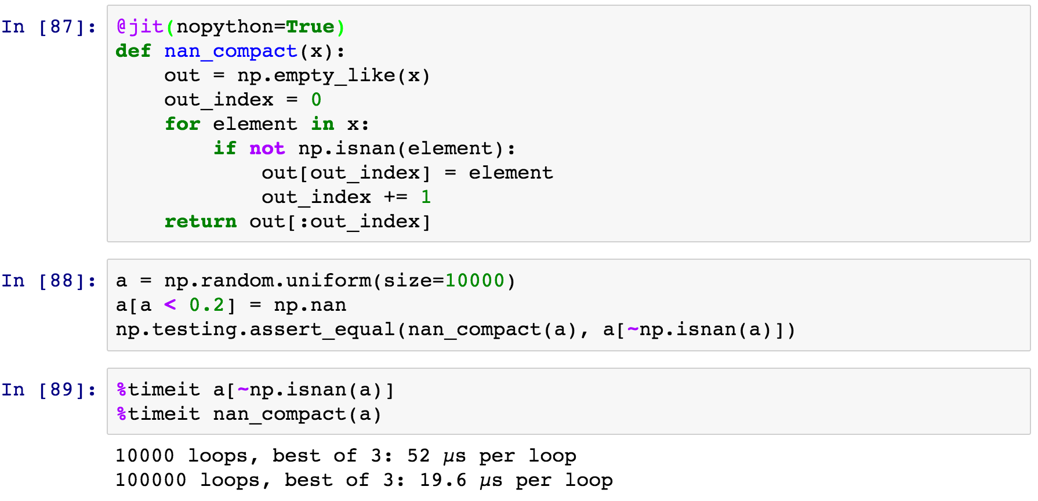
Example: Filter an array
Numba decorator (nopython=True not required)
Array Allocation
Looping over ndarray x as an iterator
Using numpy math functions
Returning a slice of the array
2.7x Speedup over NumPy!
Notes:
Does not replace the standard Python interpreter!
End user does not need a C or C++ compiler (Compiler required to compile Numba packages)
< 70 MB package
Uses LLVM to do final optimization and machine code generation.
Supports wide range of Python language constructs and numeric data types.

Slide 69
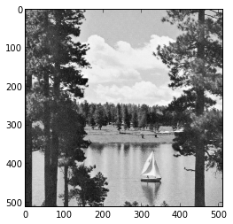
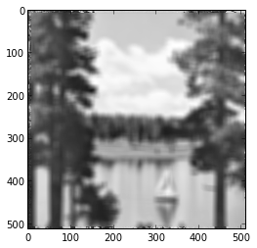
Image Processing
~1500x speed-up
@jit('void(f8[:,:],f8[:,:],f8[:,:])')
def filter(image, filt, output):
M, N = image.shape
m, n = filt.shape
for i in range(m//2, M-m//2):
for j in range(n//2, N-n//2):
result = 0.0
for k in range(m):
for l in range(n):
result += image[i+k-m//2,j+l-n//2]*filt[k, l]
output[i,j] = result

Slide 70

Numba Compatibility
Does not replace the standard Python interpreter (all of your existing Python libraries are still available)

Slide 71
Scaling Out with Dask (integrates with but doesn’t depend on Hadoop)

Slide 72
Dask
Started as part of Blaze in early 2014.
General parallel programming engine
Flexible and therefore highly suited for
Commodity Clusters
Advanced Algorithms
Wide community adoption and use
conda install -c conda-forge dask
pip install dask[complete] distributed --upgrade

Slide 73







Moving from small data to big data
Numba
Small Data
Big Data

Slide 74
Dask: From User Interaction to Execution
delayed

Slide 75





Dask: Parallel Data Processing
DAG construction and workflow manager
Synthetic views of Pandas DataFrames
with HDFS support
Synthetic views of Numpy ndarrays

Slide 76

Overview of Dask
Dask is a Python parallel computing library that is:
Familiar: Implements parallel NumPy and Pandas objects
Fast: Optimized for demanding for numerical applications
Flexible: for sophisticated and messy algorithms
Scales up: Runs resiliently on clusters of 100s of machines
Scales down: Pragmatic in a single process on a laptop
Interactive: Responsive and fast for interactive data science
Dask complements the rest of Anaconda. It was developed with NumPy, Pandas, and scikit-learn developers.

Slide 77
Dask Collections: Familiar Expressions and API
Dask array (mimics NumPy)
Dask bag (collection of data)
x.T - x.mean(axis=0)
b.map(json.loads).foldby(...)
Dask dataframe (mimics Pandas)
Dask delayed (wraps custom code)
df.groupby(df.index).value.mean()
def load(filename):
def clean(data):
def analyze(result):

Slide 78
Dask Dataframes
>>> import pandas as pd
>>> df = pd.read_csv('iris.csv')
>>> df.head()
sepal_length sepal_width petal_length petal_width species
0 5.1 3.5 1.4 0.2 Iris-setosa
1 4.9 3.0 1.4 0.2 Iris-setosa
2 4.7 3.2 1.3 0.2 Iris-setosa
3 4.6 3.1 1.5 0.2 Iris-setosa
4 5.0 3.6 1.4 0.2 Iris-setosa
>>> max_sepal_length_setosa = df[df.species == 'setosa'].sepal_length.max()
5.7999999999999998
>>> import dask.dataframe as dd
>>> ddf = dd.read_csv('*.csv')
>>> ddf.head()
sepal_length sepal_width petal_length petal_width species
0 5.1 3.5 1.4 0.2 Iris-setosa
1 4.9 3.0 1.4 0.2 Iris-setosa
2 4.7 3.2 1.3 0.2 Iris-setosa
3 4.6 3.1 1.5 0.2 Iris-setosa
4 5.0 3.6 1.4 0.2 Iris-setosa
…
>>> d_max_sepal_length_setosa = ddf[ddf.species == 'setosa'].sepal_length.max()
>>> d_max_sepal_length_setosa.compute()
5.7999999999999998

Slide 79

Dask Graphs: Example Machine Learning Pipeline

Slide 80

Example 1: Using Dask DataFrames on a cluster with CSV data
Built from Pandas DataFrames
Match Pandas interface
Access data from HDFS, S3, local, etc.
Fast, low latency
Responsive user interface

Slide 81
Dask Arrays
>>> import numpy as np
>>> np_ones = np.ones((5000, 1000))
>>> np_ones
array([[ 1., 1., 1., ..., 1., 1., 1.],
[ 1., 1., 1., ..., 1., 1., 1.],
[ 1., 1., 1., ..., 1., 1., 1.],
...,
[ 1., 1., 1., ..., 1., 1., 1.],
[ 1., 1., 1., ..., 1., 1., 1.],
[ 1., 1., 1., ..., 1., 1., 1.]])
>>> np_y = np.log(np_ones + 1)[:5].sum(axis=1)
>>> np_y
array([ 693.14718056, 693.14718056, 693.14718056, 693.14718056, 693.14718056])
>>> import dask.array as da
>>> da_ones = da.ones((5000000, 1000000),
chunks=(1000, 1000))
>>> da_ones.compute()
array([[ 1., 1., 1., ..., 1., 1., 1.],
[ 1., 1., 1., ..., 1., 1., 1.],
[ 1., 1., 1., ..., 1., 1., 1.],
...,
[ 1., 1., 1., ..., 1., 1., 1.],
[ 1., 1., 1., ..., 1., 1., 1.],
[ 1., 1., 1., ..., 1., 1., 1.]])
>>> da_y = da.log(da_ones + 1)[:5].sum(axis=1)
>>> np_da_y = np.array(da_y) #fits in memory
array([ 693.14718056, 693.14718056, 693.14718056, 693.14718056, …, 693.14718056])
# If result doesn’t fit in memory
>>> da_y.to_hdf5('myfile.hdf5', 'result')

Slide 82

Example 3: Using Dask Arrays with global temperature data
Built from NumPy n-dimensional arrays
Matches NumPy interface (subset)
Solve medium-large problems
Complex algorithms

Slide 83


Dask Schedulers: Distributed Scheduler

Slide 84

Cluster Architecture Diagram
Head Node
Client Machine
Compute Node
Compute Node
Compute Node

Slide 85

Using Anaconda and Dask on your Cluster
Single machine with multiple threads or processes
On a cluster with SSH (dcluster)
Resource management: YARN (knit), SGE, Slurm
On the cloud with Amazon EC2 (dec2)
On a cluster with Anaconda for cluster management
Manage multiple conda environments and packages on bare-metal or cloud-based clusters

Slide 86


Scheduler Visualization with Bokeh

Slide 87

Numba + Dask
Look at all of the data with Bokeh’s datashader.
Decouple the data-processing from the visualization. Visualize arbitrarily large data.
E.g. Open Street Map data:
About 3 billion GPS coordinates
https://blog.openstreetmap.org/2012/04/01/bulk-gps-point-data/.
This image was rendered in one minute on a standard MacBook with 16 GB RAM
Renders in less than a second on several 128GB Amazon EC2 instances
Notes:
* Many data scientists have to deliver dashboards to “app development” teams that use react, angular, and other javascript frameworks
* BokehJS is highly reactive and designed to play nicely with other things in the JS ecosystem
* Again, the JS snippet was only necessary to do custom linkage between the Slider and the Plot. All the basic pan, zoom, select capability in Bokeh is built-in and already can operate independently from a server.

Slide 88

Categorical data: 2010 US Census
One point per person
300 million total
Categorized by race
Interactive rendering with Numba+Dask
No pre-tiling

Slide 89
Anaconda and Hadoop

Slide 90









High Performance
Hadoop
Bottom Line
Leverage Python & R with Spark
PySpark & SparkR
Python & R ecosystem
MPI
JVM
Ibis
Bottom Line 2X-100X faster overall performance
Interact with data in HDFS and Amazon S3 natively from Python
Distributed computations without the JVM & Python/Java serialization
Framework for easy, flexible parallelism using directed acyclic graphs (DAGs)
Interactive, distributed computing with in-memory persistence/caching
Impala
High Performance,
Interactive,
Batch
Processing
Batch
Processing
Interactive Processing
NumPy, Pandas, … 720+ packages
Native
read & write
YARN
HDFS
Notes:
YARN = Resource Scheduler
JVM = Java Virtual Machine
MapReduce, Spark and Anaconda are all Compute Engines running inside Hadoop
Anaconda can also be used outside of Hadoop to connect to Spark via PySpark and SparkR
Bottom Line
10-100X faster performance
Direct read/write
No JVM overhead, No Python to Java serialization
Framework for easy parallelism
Distributed in-memory persistence/caching

Slide 91
Jupyterlab (Where Jupyter is heading)

Slide 92

JupyterLab
IDE
Extensible
Notebook -> Applications
Notes:
JupyterLab unifies the building blocks of scientific computing.

Slide 93




More Than Just Notebooks
Notes:
More Than Just Notebooks
Through your use of IPython notebooks or Jupyter Notebooks, you may have noticed that “The Notebook” in quotes is really more than just notebooks. The latest version of Jupyter -version 4- has a file browser - looking at the upper left there. There's also a text editor, you can open source code files- .py files for example, and edit those. There's a full-blown terminal so you can even run VI from the web browser and of course use the Notebooks.

Slide 94

Building Blocks
File Browser
Notebooks
Text Editor
Widgets
Output
Terminal
Notes:
So all these different parts of Jupyter, file browsers, notebooks, text editors, widgets, output in the terminal, etc. [include Fernando’s Slide] are really building blocks for interactive computing. And that is how we think of the Jupyter ecosystem.
The building blocks for interactive computing can be - Need a better segue to next slide

Slide 95
2015 User Experience Survey
Mostly daily/weekly users
Love the notebook workflow and user experience
Top needs:
Integration with version control systems (git/GitHub)
Code/text editing
Layout/integration of building blocks
Debugger, profiler, variable inspector, etc.
https://github.com/jupyter/design/blob/master/surveys/2015-notebook-ux/analysis/report_dashboard.ipynb
Notes:
2015 User Experience Survey
As I mentioned at the beginning of this talk, the team conducted a User Experience Survey in 2015 with a great deal of support from IBM (namely Peter Parente). This survey showed us who is using the notebooks, how they’re using it, and where the needs are in terms of future development.
Much of what you’re seeing on this slide comes from the survey. It also comes from watching how people like yourselves are using the Jupyter Notebook. One thing that came out the survey is that most respondents who use the notebook, use it daily. And after that, weekly, so users are generally spending a lot of time in the Jupyter Notebook environment.
In the survey, we heard very strongly from our users that they love the notebook workflow and the user experience. However, what we've also heard is that there are a lot of workflows where the notebook is a little bit painful. As users start to transition from interactive exploratory work to more software engineering, there are numerous pain points.
We've heard things like: there’s a strong need for more integration with version control systems, more support for better text editors and code editors. With the different building blocks that we have right now, you basically can only get one of those building blocks on one web page at a time. For example, you can't have a text editor next to the terminal above a notebook and also because you can't have those building blocks on the same page - it’s really hard to integrate them. For example, it would be really nice if you could take a notebook cell and just drag and drop it over a text file and have that content dropped into the text file. And then folks were looking for types of tools that show up in software engineering workflows like debuggers, profilers, and variable inspectors. (What’s that) Advantages = drag and drop, less error prone, file navigation and behavior- strong barriers across browser tabs. - Spend little time on this slide - spend on demo and wow with that

Slide 96

A completely modular architecture
Notes:
Into a completely modular architecture

Slide 97
JupyterLab
JupyterLab is the natural evolution of the Jupyter Notebook user interface
JupyterLab is an extensible IDE: Interactive Data Environment
Flexible user interface for assembling the fundamental building blocks of interactive computing
Modernized JavaScript architecture based on npm/webpack, plugin system, model/view separation
Built using PhosphorJS (http://phosphorjs.github.io/)
Design-driven development process
https://github.com/jupyter/jupyterlab
Notes:
JupyterLab
We like to think of JupyterLab as the natural evolution of the Jupyter Notebook user interface. Since we first shared JupyterLab, people have asked us “is it an IDE? It looks like an IDE!” And our answer is yes, if by IDE you mean an interactive development environment.
JupyterLab has a flexible user interface that allows users to combine the different building blocks of scientific computing in ways to support the workflows that they happen to have at the moment, whether its more the interactive exploratory workflow or something that looks more like DevOps or software engineering. We have a modernized JavaScript architecture underneath this. It's built using phosphor.js which is an open source library for building web applications that have a lot of capabilities of desktop applications.
And we're really taking a very design-driven development approach. We have a number of designers working with us on this project. We're taking user testing very seriously; a number of people participated in user testing at SciPy in Austin recently and we really appreciate that. The response to JupyterLab has been fantastic. In fact, we had over a hundred people sign up or request to participate in the JupyterLab user testing.

Slide 98






The “Notebook”?

Slide 99
Data Science Workflow
Data Products
Exploratory Data Analysis and Viz
Reports
Applications
Understand Data
Notebooks
Decisions
and
Actions
Getting Data
Models
Dashboards
Understand World
Microservices
New Data

